Slide 1
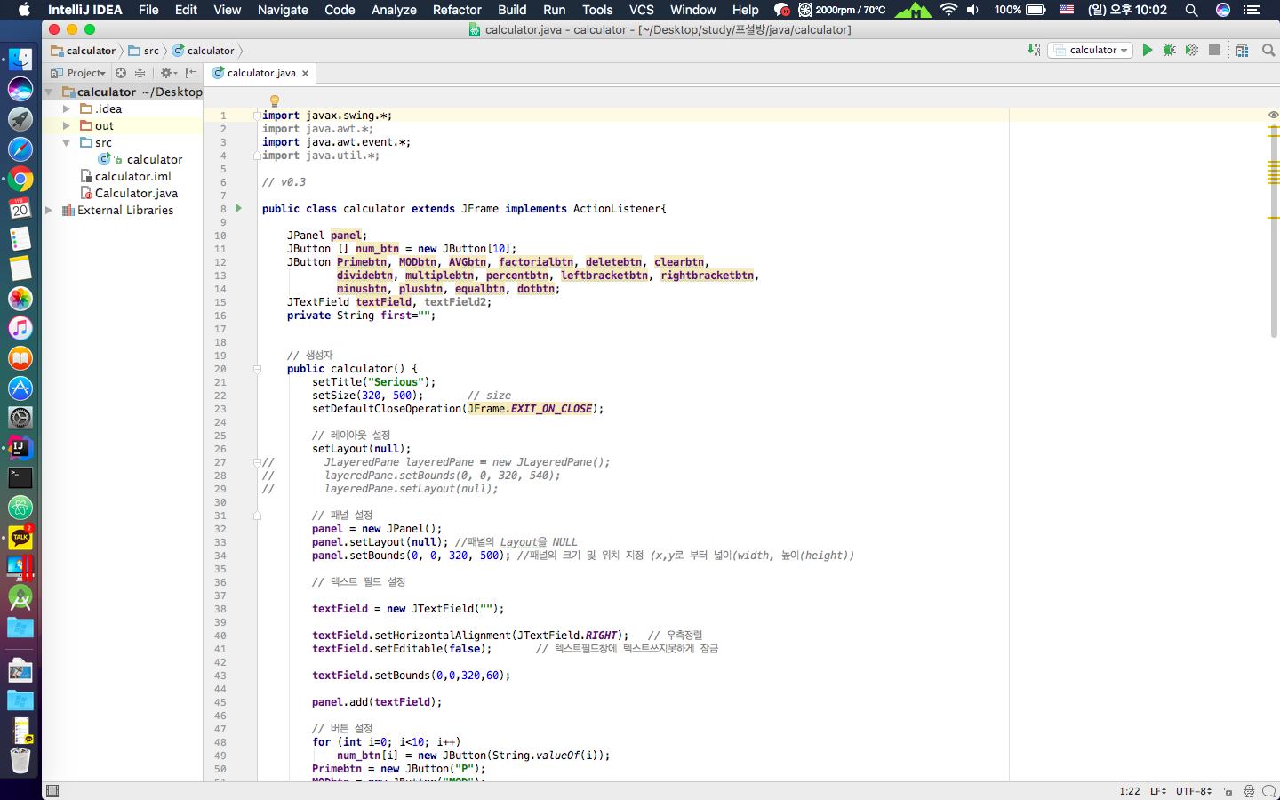
Open-Source SW
#28 - simpsons

Slide 2
Contents
Project
Calculator
Github
Role
Serious
Next

Slide 3
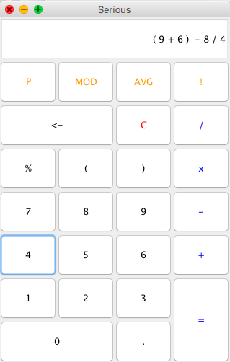
Project
Serious
Calculator -
JAVA Desktop App

Slide 4
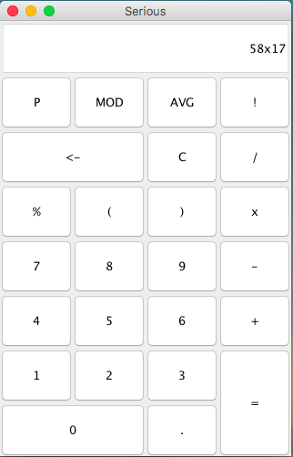
Serious – Old
Text field
Button
Set Location
Input function

Slide 5
Serious – New
Text field

Slide 6
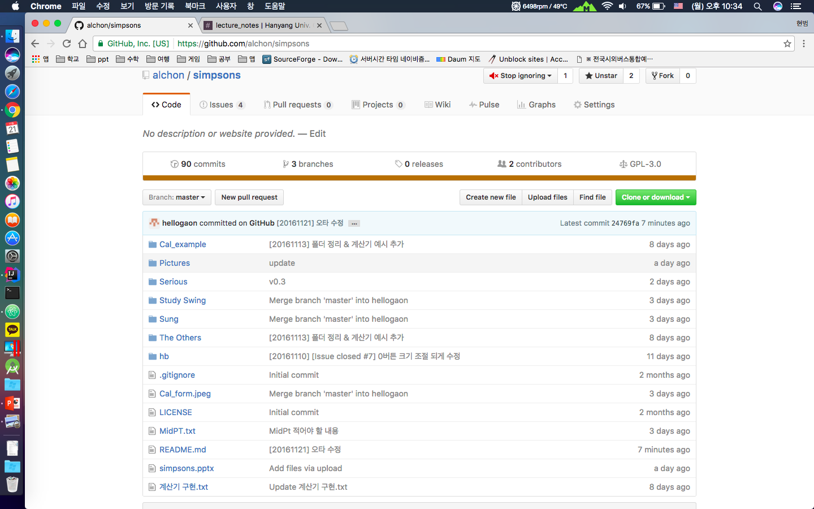
Github

Slide 7
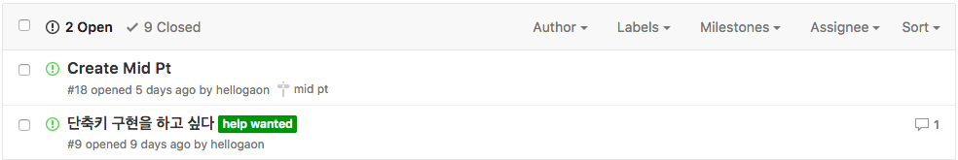
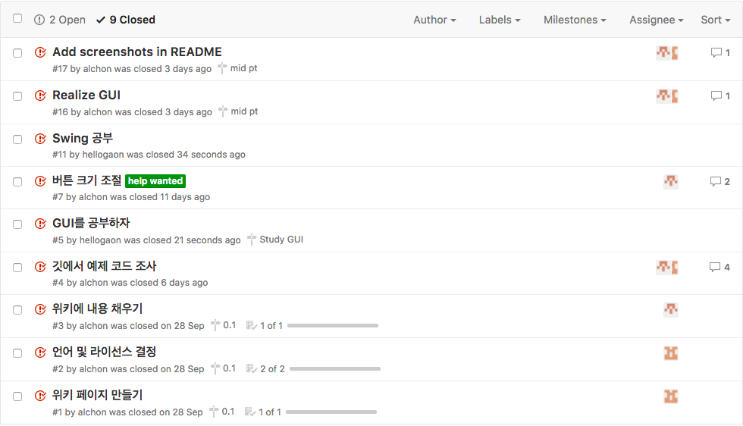
Github - Issue

Slide 8
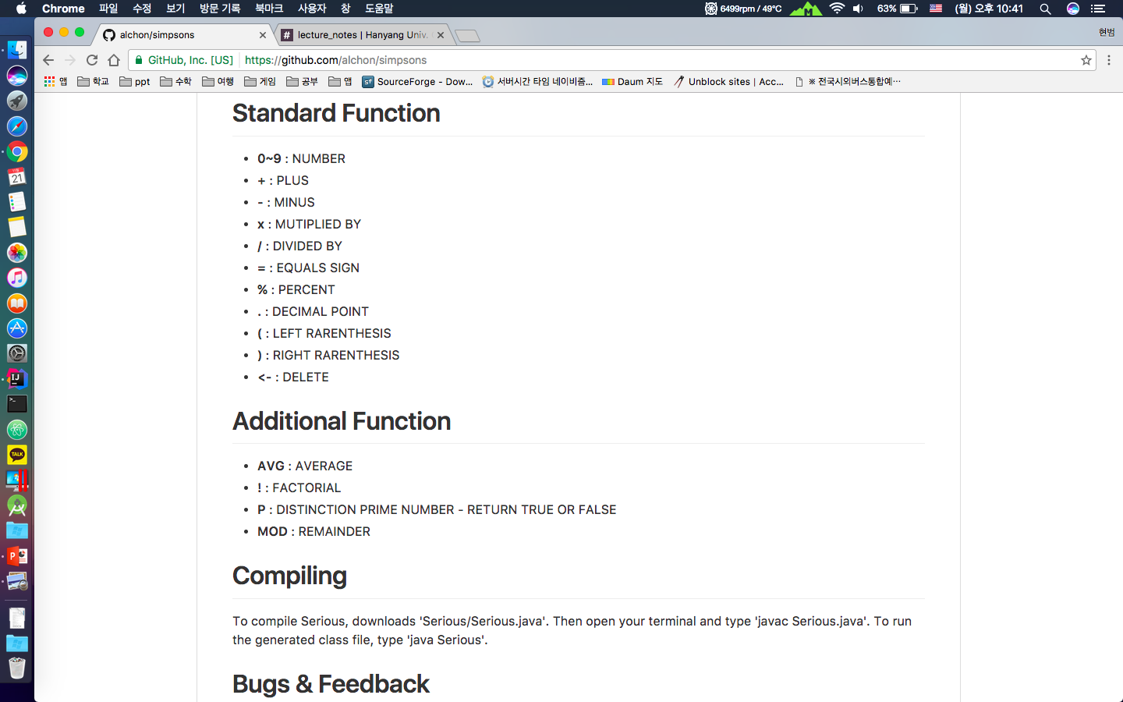
Github - README
Https://github.com/alchon/simpsons

Slide 9
Serious - Next
Next Version
Calculate
Menu bar
Hotkey
Design
And so on …

Slide 10
THANK YOU!

Slide 11
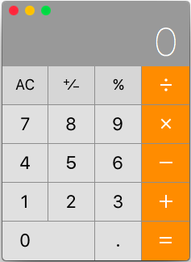
Calculator
General Function
+
Plus
-
Minus
x
Multiply
/
Division
%
Percent

Slide 12

Serious
NEW Function
P
Distinction Prime number
MOD
Remainder
AVG
Average
!
Factorial

